Slide 1

Introducing
The Pizza Sales Analysis Report using SQL
Utkarsh Srivastava

Slide 2
Hello !
In this Project I am utilizing the SQL to undertake an comprehensive analysis of pizza sales with the aim of deriving valuable insights and informed strategic decision making process.

Slide 3
Project Overview
The objective is to utilize advanced data analysis methodologies to extract actionable insights from a comprehensive database, this initiative empowers the business to make well informed decision, thereby facilitating strategic growth within the competitive pizza industry.

Slide 4
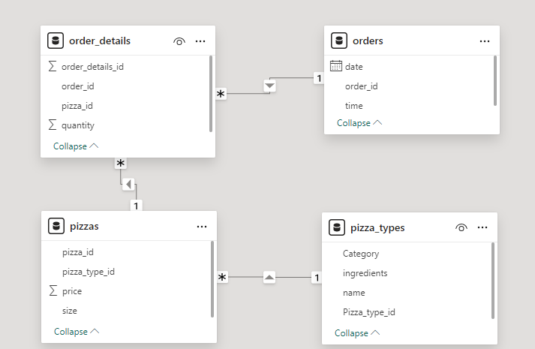
Pizza Sales Insights through Data Modeling
Pizza sales data to understand relationship between orders, pizzas, order_details and Pizza_types

Slide 5
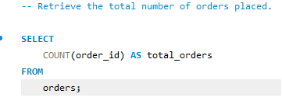

rrRe
Retrieve the total number of orders placed

Slide 6
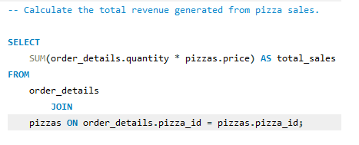

Calculate the total revenue generated from pizza sales

Slide 7
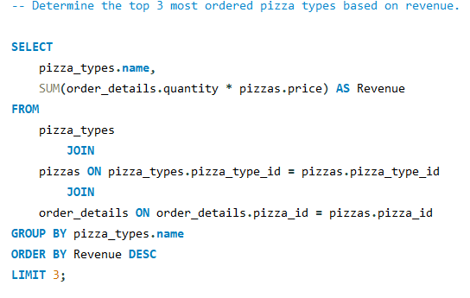
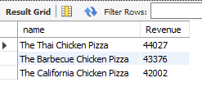
Determine the top 3 most ordered pizza types based on revenue

Slide 8
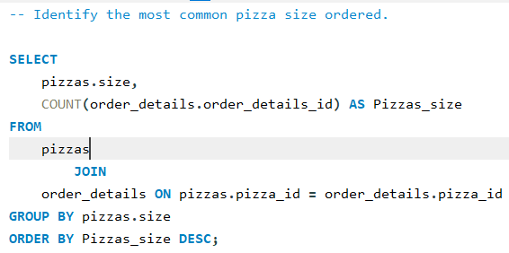
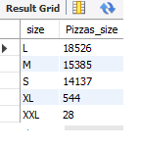
Identify the most common pizza size ordered

Slide 9
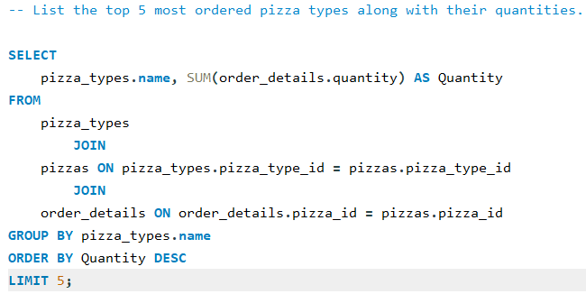
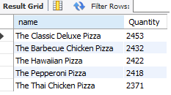
List the top 5 most ordered pizza types along with their quantities.

Slide 10
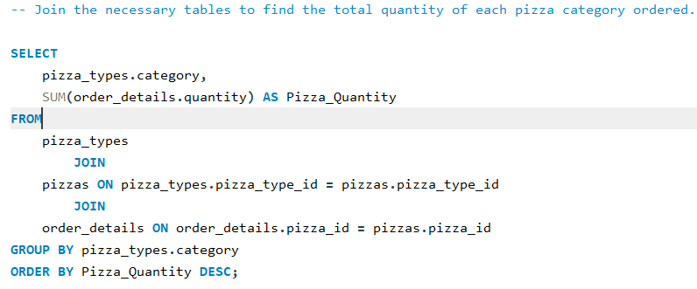
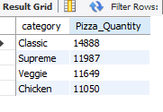
Join the necessary tables to find the total quantity of each pizza category ordered

Slide 11
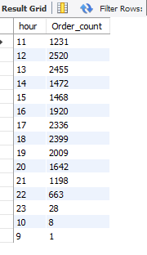
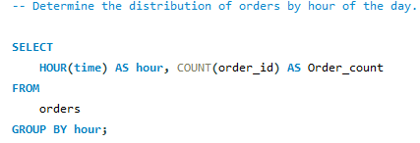
Determine the distribution of orders by hour of the day

Slide 12
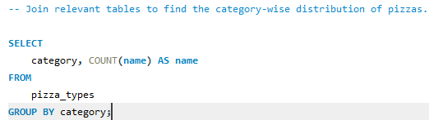
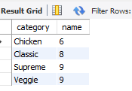
Join relevant tables to find the category wise distribution of pizzas

Slide 13
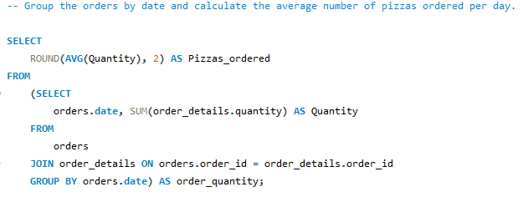

Group the orders by date and calculate the average number of pizzas ordered per day

Slide 14
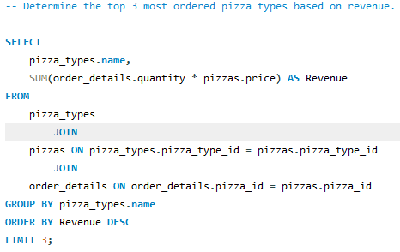

Determine the top 3 most ordered pizza types based on revenue

Slide 15
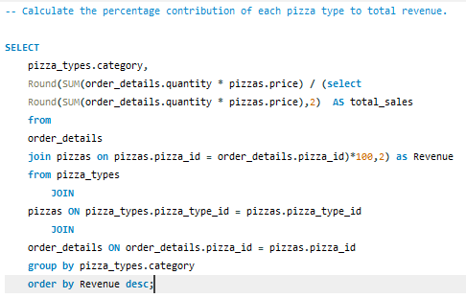
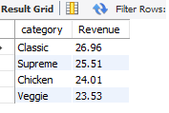
Calculate the percentage contribution of each pizza type to total revenue

Slide 16
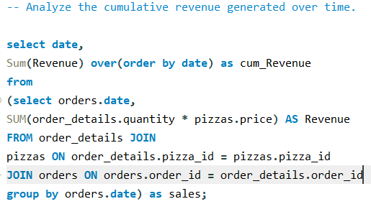
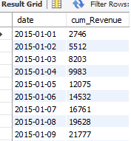
Analyse the cumulative revenue generated over time

Slide 17

Thank You !
For much such content you can follow me on
LinkedIn

